Slide 1
Contents
Bỏ thời gian đi
1
Introduction – 10 min
2
Plan – 5 min
3
Development process – 30 min
4
Demo – 15 min
5
Q&A – 30 min

Slide 2
Project management
Quality Assurance
Result
Introduction
Group
GROUP INTRODUCTION
Project name: Credit Ranking System
Supervisor: Mr. Quang LT
Students:
- Đào Mai Ly
- Trần Thị Hương Giang
- Phạm Thị Phương Thảo
- Phan Lê Quang Chính
- Nguyễn Thanh Long
Presentation view-point
Business context
Plan
Development process
SRS
Design
Implement
Testing
Demo
Q&A

Slide 3
Project management
Quality Assurance
Result
Introduction
BUSINESS CONTEXT
Group
Presentation view-point
Finance
Banking
Business context
Deposit
Others
Credit
Ranking
Plan
Development process
AAA
AA
A
BBB
BB
B
CCC
CC
C
D
Business
customer
Individual
customer
SRS
Design
Implement
Evaluation Ranks
Financial Index
Non Financial Index
Business Scale
........
Basic Index
Collateral Index
........
Testing
Demo
Q&A
FPT University

Slide 4
Project management
Quality Assurance
Result
Introduction
Classifying
Group
BUSINESS CONTEXT
Presentation view-point
Business Process conclusion
Business context
Plan
Input
Process
Output
Customer
Rank
Development process
Customer
Info
Ranking
SRS
Design
Implement
Ghi quy tac danh gia o day
Testing
Clustering
Demo
New Approach
Q&A
Banking Credit System
FPT University

Slide 5
Project management
Quality Assurance
Result
Introduction
Time table
Group
Presentation view-point
Project management
Business context
Quality Assurance
Review
Plan
Feasibility study
Require
ment
Create TC
Integration test
Deploy
Development process
DB & AD
Implement
DD
SRS
Design
Oct
Nov
Dec
Jan
Feb
Mar
Apr
Implement
Testing
Demo
Q&A

Slide 6
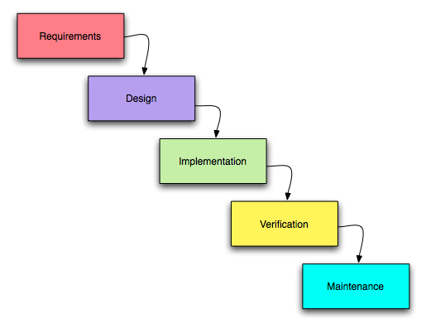
Project management
Quality Assurance
Result
Introduction
Process model – Waterfall model
Group
Presentation view-point
Reason:
Simple and familiar model
Short-term project
Due to Report submissions
Business context
Plan
Development process
SRS
Design
Implement
Testing
Demo
Q&A

Slide 7
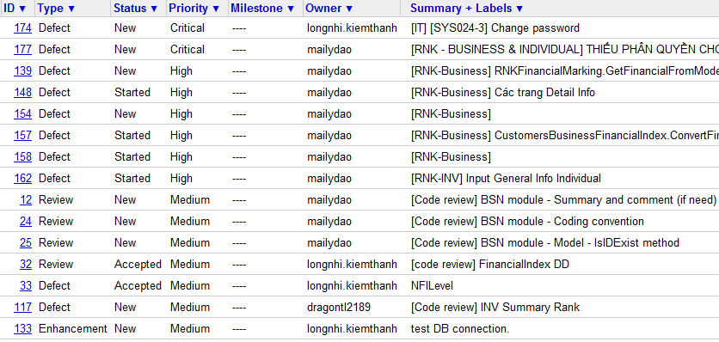
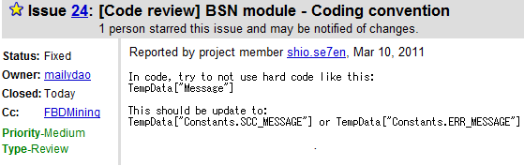
Project management
Quality Assurance
Result
Working process – Bug management

Slide 8
Project management
Quality Assurance
Result
Introduction
Group
BSN | FI NFI | INV | SYS |RNK |RPT
Presentation view-point
Business context
Plan
Elicitation
Analysis &
Negotiation
Development process
SRS
Documenting
Validation
Design
Implement
Testing
Demo
Q&A

Slide 9
Project management
Quality Assurance
Result
BUSINESS CONTEXT
CREDIT RANKING PROCESS FOR BUSINESS CUSTOMERS
Credit dept
manager
Risk managing
staff
Risk dept
manager
Branch
Director
Credit staff
Receive request ranking
Request for updating
Collect customer information
Identify customer’s industry operation
Marking for Financial Indexes
Marking for Non-Financial Indexes
Calculate total score
Summary Evaluation
Validation
Evaluation
Verified
Accepted
Committing Result

Slide 10
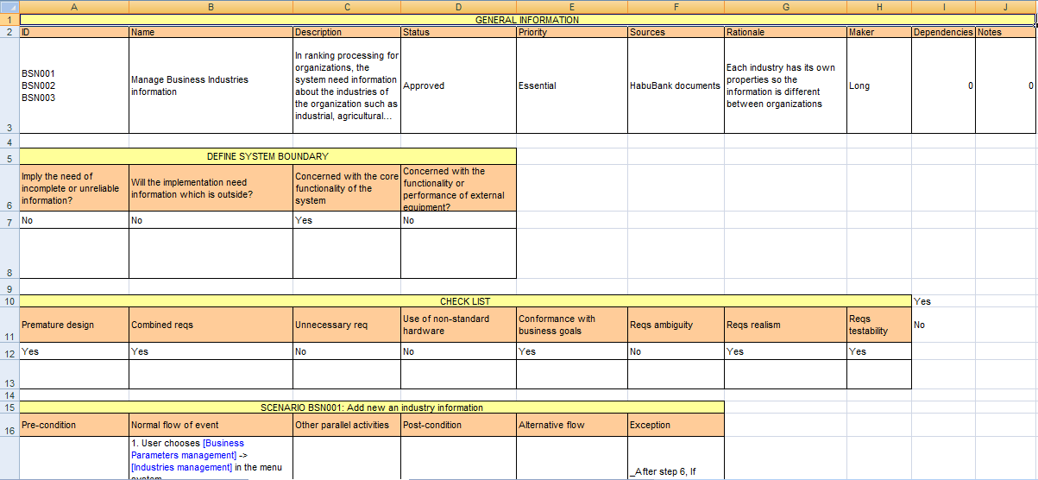
Project management
Quality Assurance
Result
Introduction
SRS Template
Group
Presentation view-point
Business context
Plan
Development process
SRS
Design
Implement
Testing
Demo
Q&A

Slide 11
Project management
Quality Assurance
Result
Introduction
Review action:
Review within sub-team.
Cross-review of two sub-team
Customers clarification.
Group
Presentation view-point
Business context
Plan
Development process
SRS
Design
Implement
Testing
Demo
Q&A

Slide 12
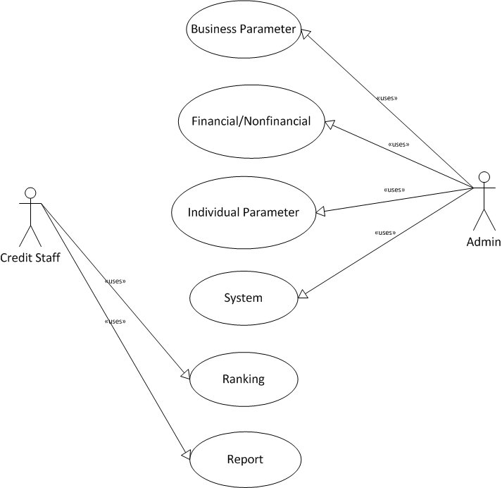
Project management
Quality Assurance
Result
Introduction
Thiếu khung boundary
FUNCTIONAL REQUIREMENT
Use cases:
22 BSN use cases
33 INV use cases
14 NFI use cases
9 FI use cases
24 SYS use cases
17 RNK Use cases
2 RPT use cases
Group
Presentation view-point
Business context
Plan
Development process
SRS
Design
Implement
Testing
Demo
Q&A

Slide 13
Project management
Quality Assurance
Result
Introduction
NON FUNCTIONAL
Security
Group
Presentation view-point
ID | Type
SEC001 | Identification
SEC002 | Authentication
SEC003 | Authorization
SEC004 | Privacy
SEC005 | Immunity
SEC006 | Integrity
Business context
Plan
Development process
SRS
Design
Implement
Testing
Demo
Q&A

Slide 14
Project management
Quality Assurance
Result
Introduction
NON FUNCTIONAL
Performance
Group
Presentation view-point
Business context
ID | Type | Requirement
PER001 | Response time | The average time to response for a transaction when managing parameters is 2s and the maximum is 5s. The average time to response for a transaction when ranking for customers is 3s and the maximum is 8s
PER002 | Capacity | The system can accommodate for a maximum number of 1000 users at different locations
Plan
Development process
SRS
Design
Implement
Testing
Demo
Q&A

Slide 15
Project management
Quality Assurance
Result
Introduction
I. DB design
Goal:
Solve business requirement.
Try following 3 Normal Form.
Inherit customer data
Approach:
Bottom up
Design and edit, review, merge in Visio then create DB
Result:
Group
Presentation view-point
Business context
Plan
Development process
SRS
Design
Implement
Testing
Demo
Q&A

Slide 16
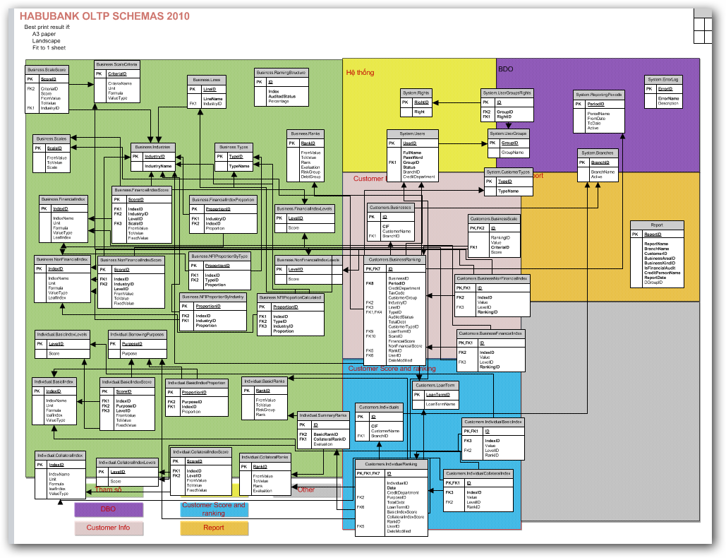
Project management
Quality Assurance
Result
Introduction
DB design
Thieu ERD
Group
Presentation view-point
Business context
Plan
Development process
SRS
Design
Implement
Testing
Demo
Q&A

Slide 17
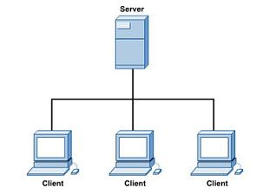
Project management
Quality Assurance
Result
Introduction
II. System Design
Base on non-Functional requirement:
Need a lot of user using common DB
Group
Presentation view-point
Business context
Plan
Development process
SRS
Design
Implement
Testing
Demo
Q&A

Slide 18
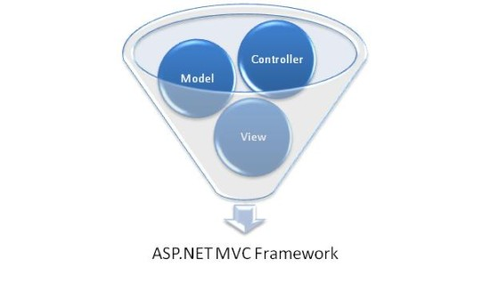
Project management
Quality Assurance
Result
Introduction
Group
MVC architecture
Framework : Using MVC( Microsoft MVC .Net 2.0)
Advance :
beside common advance, it save our time
Presentation view-point
Business context
Plan
Development process
SRS
Design
Implement
Testing
Demo
Q&A

Slide 19
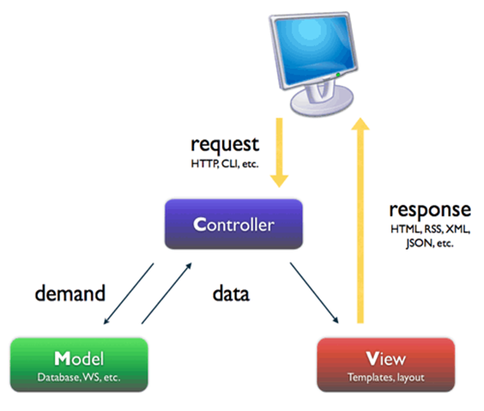
Project management
Quality Assurance
Result
Introduction
MVC architecture
Group
Presentation view-point
Business context
Plan
Development process
SRS
Design
Implement
Testing
Demo
Q&A

Slide 20
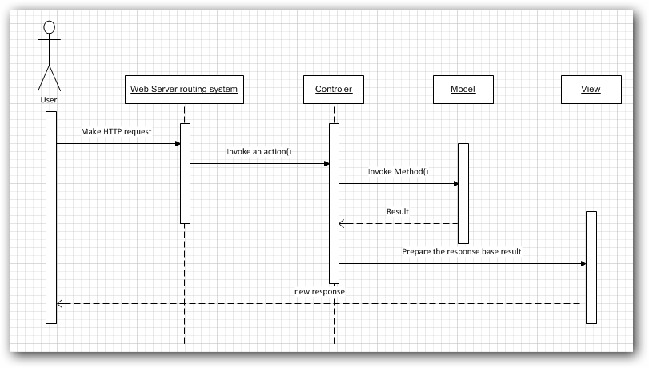
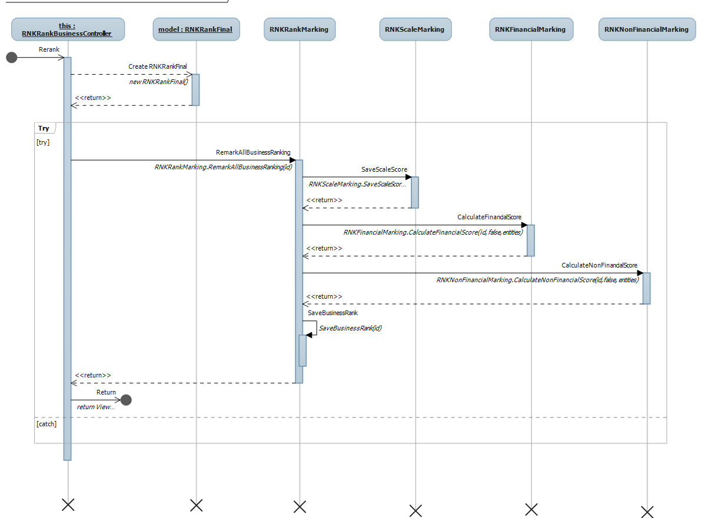
Project management
Quality Assurance
Result
Cái này thừa

Slide 21
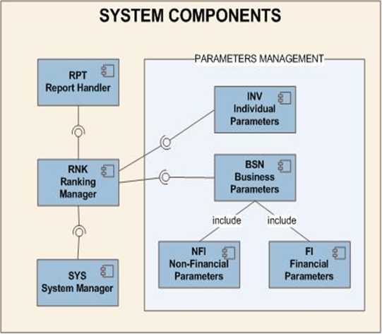
Project management
Quality Assurance
Result
Introduction
Component Diagram:
Group
Presentation view-point
Business context
Plan
Development process
SRS
Design
Implement
Testing
Demo
Q&A

Slide 22
Project management
Quality Assurance
Result
Introduction
Detail design
Goal:
- Describe all class, function in this program
Approach:
- Bottom up:
each person design a function,
- Using our excel template and MS Visio.
Group
Presentation view-point
Business context
Plan
Development process
SRS
Design
Implement
Testing
Demo
Q&A

Slide 23
Project management
Quality Assurance
Result
Introduction
Implemented modules
Group
Presentation view-point
Business context
Administration
Plan
Parameters
Development process
Ranking
SRS
Design
Customer Clustering
Implement
Testing
Demo
Report
Q&A

Slide 24
Project management
Quality Assurance
Result
Introduction
K-means algorithm for Customer clustering
Definite:
k-means clustering is a method of cluster analysis which aims to partition n observations into k clusters in which each observation belongs to the cluster with the nearest mean.
Group
Presentation view-point
Business context
Plan
Development process
SRS
Design
Implement
Testing
Demo
Q&A

Slide 25
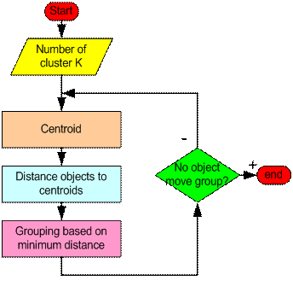
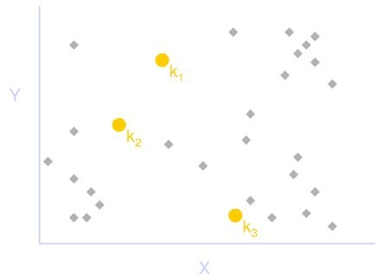
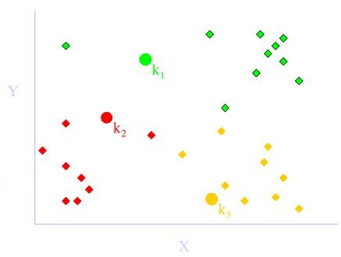
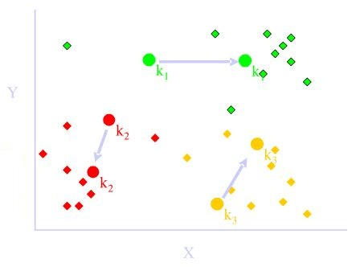
Project management
Quality Assurance
Result
K-means Algorithm flow chart

Slide 26
Project management
Quality Assurance
Result
Introduction
Testing activities
Code
Unit test
Review code
Integration test
Log bug
Group
Presentation view-point
Business context
Plan
Development process
SRS
Design
Implement
Testing
Demo
Q&A

Slide 27
Project management
Quality Assurance
Result
Introduction
Test strategy follows V-model
Group
Presentation view-point
Developing
Testing
Business context
Coding
Acceptance
System
Integration
Unit
Requirements
High-level design
Detailed design
Plan for
Plan
Development process
SRS
Design
Implement
Testing
Demo
Q&A

Slide 28
Project management
Quality Assurance
Result
Introduction
Testing process
Group
Presentation view-point
Create TC template
Write TC (based on SRS)
Review TC
Create test data
IT
Business context
Plan
Development process
SRS
Design
Implement
Testing
Demo
Q&A

Slide 29
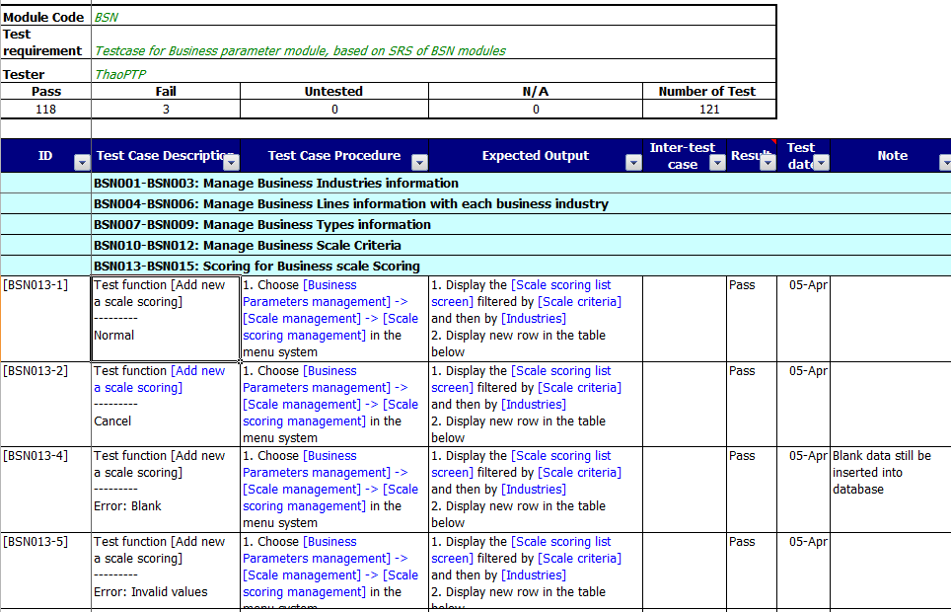
Project management
Quality Assurance
Result
Introduction
Test case
Group
Presentation view-point
Business context
Plan
Development process
SRS
Design
Implement
Testing
Demo
Q&A
Test case

Slide 30
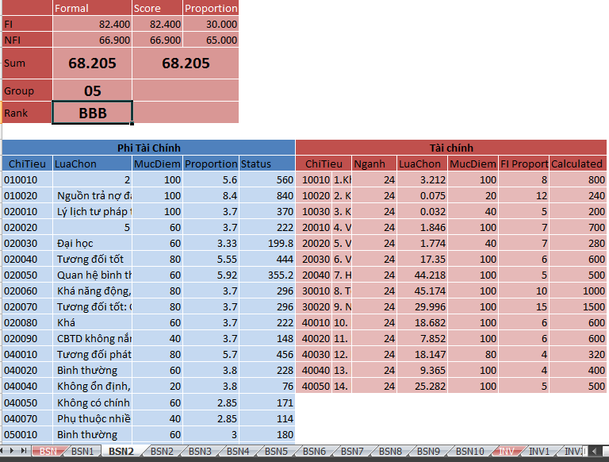
Project management
Quality Assurance
Result
Introduction
Test data
Group
Presentation view-point
Business context
Plan
Development process
SRS
Design
Implement
Testing
Demo
Q&A

Slide 31
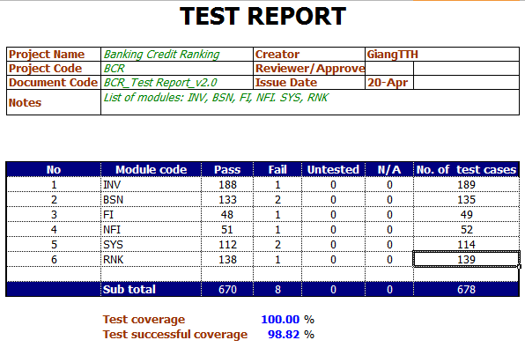
Project management
Quality Assurance
Result
Introduction
Test report
Group
Presentation view-point
Business context
Plan
Development process
SRS
Design
Implement
Testing
Demo
Q&A

